Slide 1
Welcome Urban and Rural Service Management Committee

Slide 2
2015 Health Impact Assessment of the urban and rural services management policy
Findings and Recommendations

Slide 3
This analysis focuses on addressing the potential health impacts and prospective health goals of the establishment of an Urban and Rural Services Management (URSM) Policy as a means of preserving quality, sustainable public services such as water and sewer in the urbanized areas of cities, villages, and townships in the mid-Michigan region, while protecting farmlands, open spaces, and rural quality in undeveloped areas.
This HIA is another tool in our policy “toolkit” . . .

Slide 4
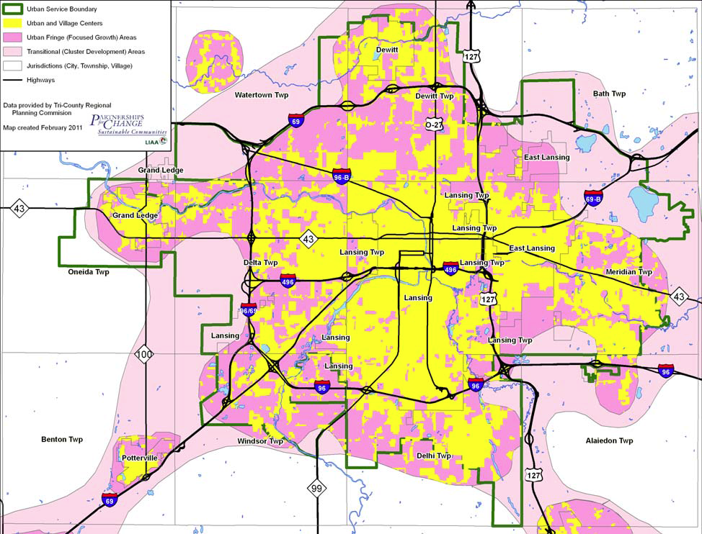
To keep urbanized areas viable. To protect farmland, open space, and rural quality of life. To preserve priority conservation areas. To utilize existing infrastructure. To cost‐save through cooperation and efficiency.

Slide 5
What is an HIA?
An HIA is a structured process that uses scientific data, professional expertise, and stakeholder input to identify and evaluate public-health consequences of policies and projects and suggests actions that could be taken to minimize adverse health impacts and optimize beneficial ones.

Slide 6
findings
Costs to expand water and sewer infrastructure place a burden on community resources that would otherwise be available to maintain existing systems, in addition to providing other public services for disadvantaged populations.
Additional property taxes to support expansion of water and sewer infrastructure may adversely affect household budgets at the expense of health care affordability.
Urban development or land-use change in rural areas resulting from expansion of water and sewer infrastructure may result in loss of productive farmland, recreational opportunities, sensitive natural areas, and sense of wellbeing. These effects may lead to increasing stress and anxiety to residents and family-owned agricultural businesses in rural areas and eliminate a rural lifestyle choice.
Urban development or land-use change in rural areas resulting from expansion of water and sewer infrastructure could reduce the availability of healthy locally grown food, which could lead people to substitute unhealthy food options or spend more money to travel and purchase healthy food, potentially impacting obesity rates or household budgets, leading to stress and decreased access to health care.
Land-use conflicts and declines in capital improvement budgets create stress and place additional financial burdens on populations least able to adapt to changing growth and development policies in a community. Disadvantaged populations can become economically marginalized and may be forced to relocate.
Communities with a mix of urban and rural land uses may have to prioritize between new greenfield development versus redevelopment or infill opportunities, new subdivisions versus preservation of farmland and open space, and so on.
Annexation of township land by municipalities may result in conflict between jurisdictions, changes in development priorities and revenue generation, and dramatically increase tax rates for businesses and homeowners. Small businesses and vulnerable populations are at greatest risk in annexation proposals.

Slide 7
Recommendation 1: Responsible, environmentally sound, and socially and economically equitable growth should be a continuing goal of every community. Communities in the mid-Michigan region are encouraged to establish service boundaries or service management areas. The URSM policy provides guidelines and support to communities that desire to manage growth within their jurisdictions.
Recommendation 2: Communities in the mid-Michigan region are encouraged to locate development within areas that can accommodate growth with existing infrastructure (e.g., water and sewer, roads, etc.) with minimal effect on non-compatible uses. It includes safeguarding sensitive areas such as riparian buffers, wetlands, and critical habitat from development pressures; directing new development to infill, brownfield, and greyfield sites to take advantage of existing infrastructure and preserve green space; and putting homes, workplaces, and services close to each other in convenient, accessible locations.
Recommendation 3: Communities in the mid-Michigan region are encouraged to consider practices and technologies in which the built environment can protect and enhance health and the quality of life for all residents. In addition to providing safe and cost-effective public services like water and sewer, communities can encourage walkability and bikeability; public open spaces; safe routes to schools and public places; and buildings that are low-impact, energy efficient, and make maximum use of sustainable materials in all new developments within their jurisdictions.
Recommendation 4: Communities in the mid-Michigan region that are currently growing or likely to grow in the future should consider adopting a policy of directing potential growth into areas within their jurisdictions that can accommodate growth while minimizing adverse impacts to sensitive natural areas and open space, productive agricultural lands, and recreation areas.
Recommendation 5: Communities are encouraged to adopt a Health In All Policy as a means of ensuring that the health effects of a land-use decision are considered equally with economic, fiscal, and engineering considerations of a proposed development.

Slide 8
Next Steps
TCRPC staff will continue to provide information and education to local communities on adopting URSM Areas, as well as general information on adopting a Health In All Policy, integrating health considerations in planning decisions, and conducting local HIAs with the help of our new Online Mapping Tool.
Through our committee interviews in 2014, we have a list of communities who are interested in learning about the new Health Impact Assessment Online Mapping Tool.

Slide 9
The online mapping tool
http://hiatoolkit.weebly.com/

Slide 10
Funding for this study was provided by the Ingham County Health Department & Michigan State University School of Planning, Design and Construction with a grant from the Health Impact Project, which is a collaboration between the Robert Wood Johnson Foundation and The Pew Charitable Trusts. Many thanks to Mike Thomas, PhD. and Janine Sinno, PhD.
Additional Support provided by the Tri-County Regional Planning Commission through a grant from the U.S. Dept. of Housing and Urban Development’s Office of Economic Resiliency. (formerly Office of Sustainable Communities).
The full health impact assessment is available online at: http://hiatoolkit.weebly.com/projects-and-hia-practices.html
Please visit www.midmichigansustainability.org for more information.

